Slide 1




Insaid Telecom
Group: 1003

Slide 2
Outline
Data Source
Problem Statement
Problem Analysis
Insights from Analysis
Data science Tools used
Recommendable insights

Slide 3
Data Source
The data was collected from mobile apps that use Insaid Telecom services.Full recognition and consent from individual user of those apps have been obtained, and appropriate anonymization have been performed to protect privacy.
Three datasets were used
gender_age_train: Devices and their respective user gender, age and age_group
phone_brand_device_model: device ids, brand, and models phone_brand (few brands are in Chinese)
events_data: event id, device id, timestamp, location (lat/long), city and state.

Slide 4
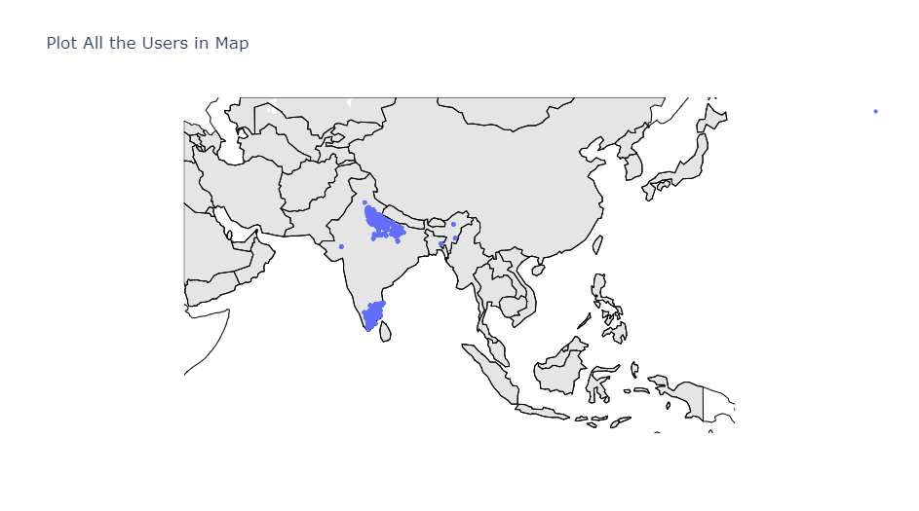
Problem Statement
-
We are going to study the demographics of a user (gender and age) based on their app download and usage behaviors.
States to focus for Consulting
Tamil Nadu
Manipur
Chandigarh
Tripura
Uttar Pradesh
Arunachal Pradesh

Slide 5
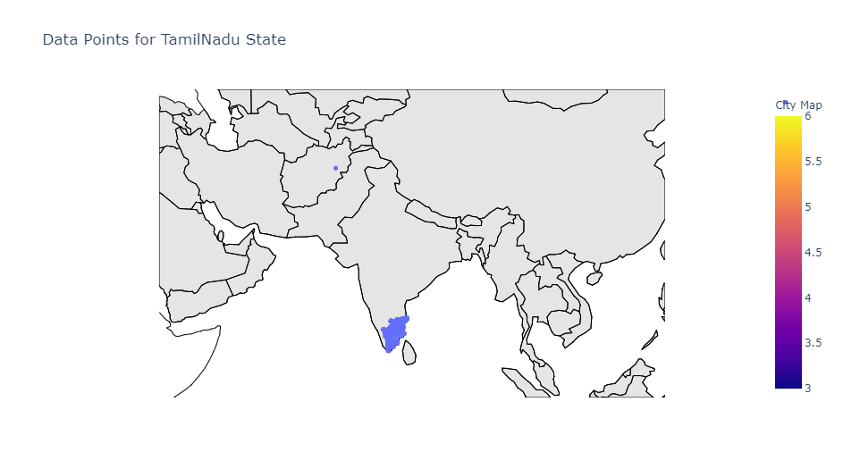
Problem Analysis
TamilNadu
The incorrect data (longitude and latitude) present in 9 rows in Pakistan have been replaced with the correct longitudes and latitudes for the same device_id.

Slide 6
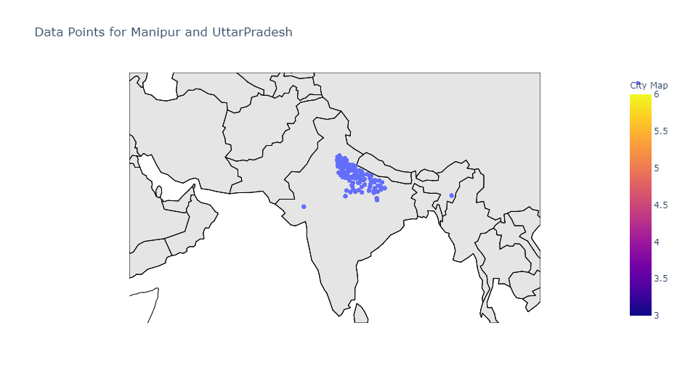
Problem Analysis
Uttar Pradesh, Manipur
we found that one of the cities named 'Kadi' has incorrect state. It is part of Gujarat state but as per data it is Uttar Pradesh. So, we updated the state of 947 rows having city=Kadi from Uttar Pradesh to Gujarat.

Slide 7
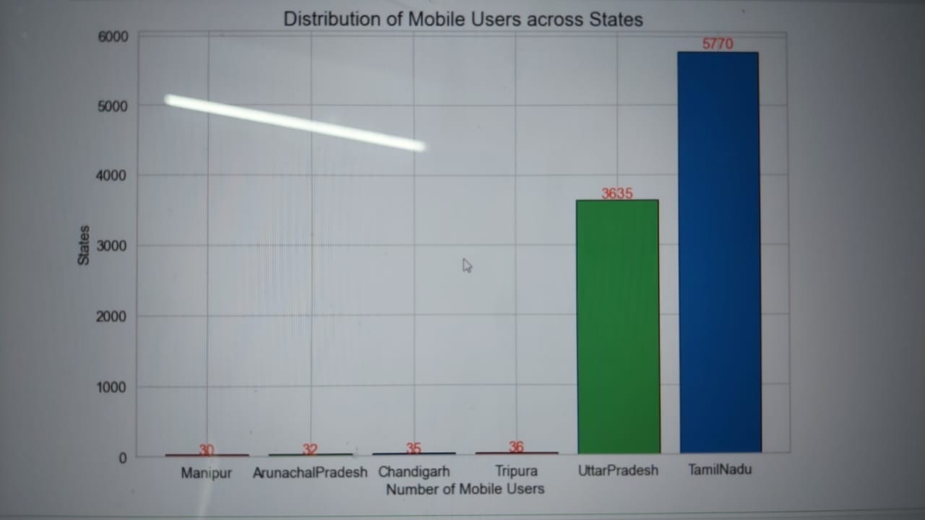
Insights from Analysis
01
Tamil Nadu and Uttar Pradesh has 60% and 38% Mobile users
1
List any research or data you have to support the need for a solution.

Slide 8
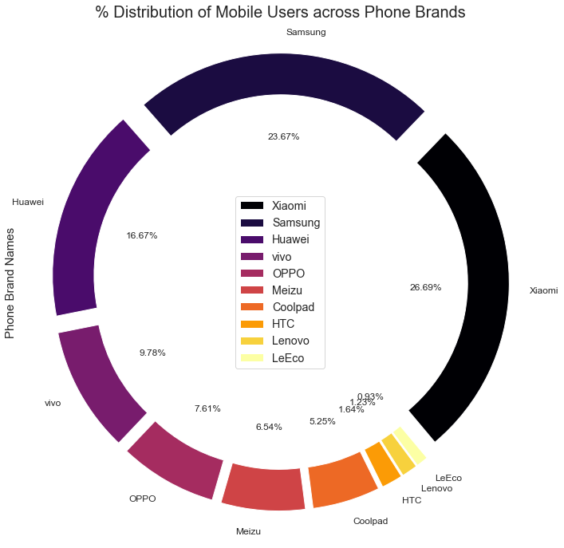
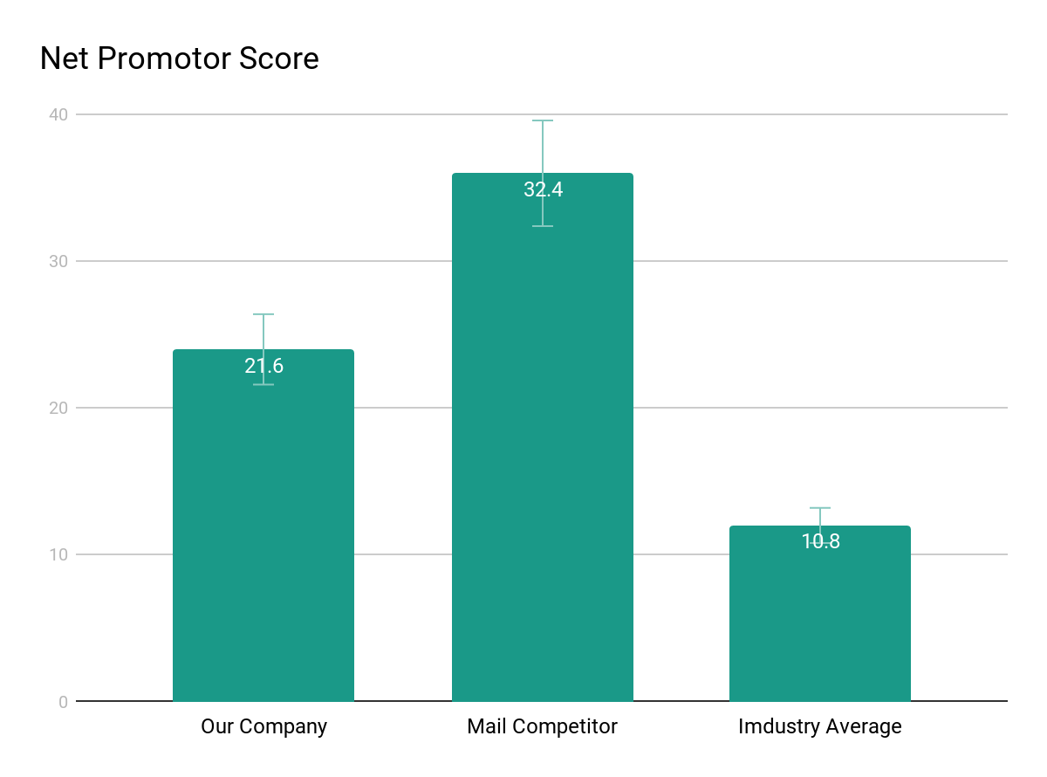
Insights from Analysis
02
Distribution of Mobile Users across Phone Brands
1
23.67%
Xiaomi(26.69%),
Samsung(23.67%) and
Huawei(16.67%) are the top 3 most used phone brands.
These 3 companies comprise more than 67% of market share in these 6 states.
16.67%
26.69%

Slide 9
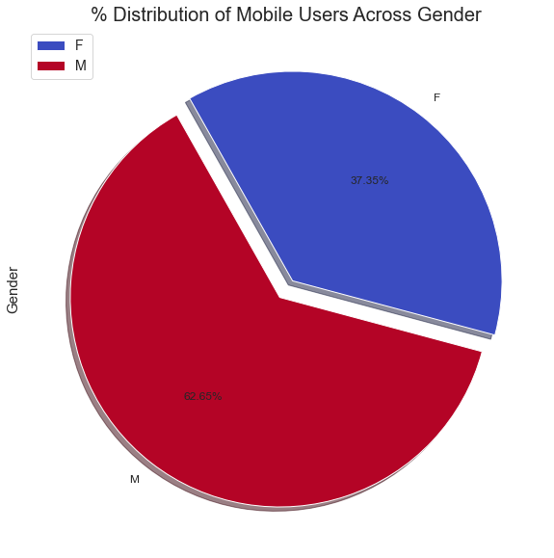
Insights from Analysis
03
Distribution of Mobile Users across Genders
1
23.67%
Insaid Telecom has more Males users(62.65%) compared to Female users(37.35%) in these 6 states.
16.67%
26.69%

Slide 10
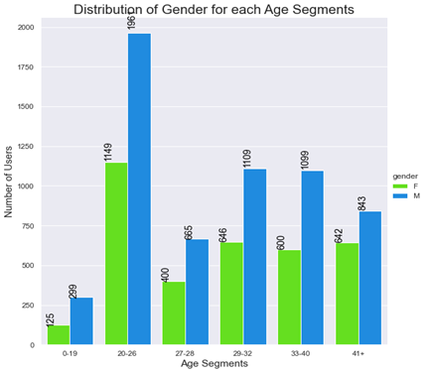
Insights from Analysis
04
1
People in the range of 20 yrs to 26 yrs prefer this network the most compared to other age group.
Most of the users(more than 80%) are of the age 20yrs to 40yrs.

Slide 11
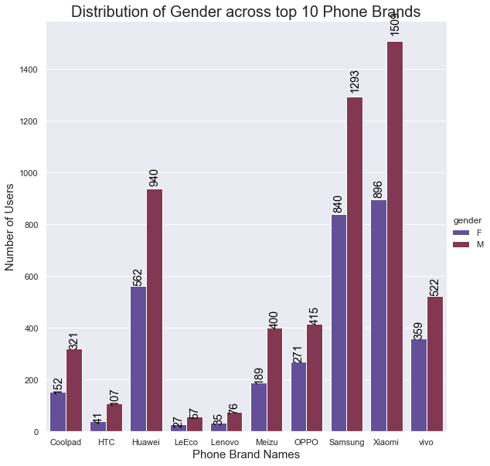
Insights from Analysis
05
·Xiaomi was the most preferred mobile brand for each age categories.
·However, Samsung had a slightly more preferred over Xiaomi for age segment 40+.

Slide 12
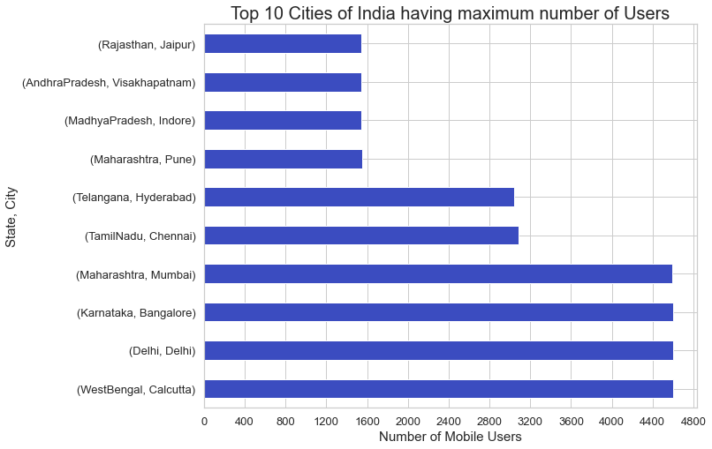
Insights from Analysis
06
Calcutta has the maximum number of users followed by Delhi, Bangalore, Mumbai, Chennai
1
16.67%
26.69%

Slide 13
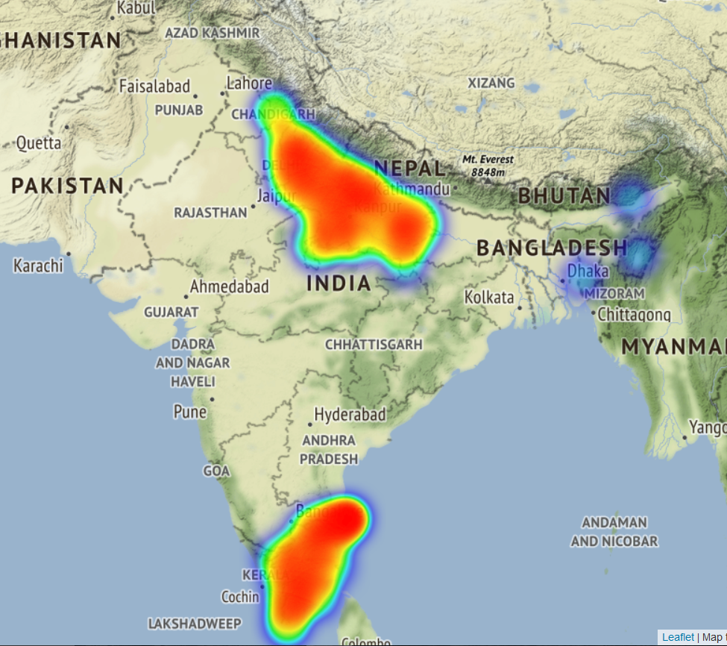
All State Users 07

Slide 14
Data science Tools used
Mysql for utilizing web data
Folium Package for visualizing Geographic locations on map
Kaleido for web based visualization
Numpy for Numerical Analysis
Pandas for Panelled data structure analysis
Seaborn and Matplot for Data visualization and Graphical representation

Slide 15
Recommendable insights
- Scope to increase user base particularly in Manipur, Chandigarh, Tripura & Arunachal Pradesh through better network coverage and attractive plans particularly aimed at the age segment 20-40 years
- Xiaomi & Samsung being the most popular brands, we could tie up with them to provide Insaid Telecom connection along with the handset at an attractive price
- Special offers/ plans for females, launched on specials occasions like Women's Day, Mother's day etc could help increase Female user base
- Introduce special plans/offers for usage between 2:00 AM and 7:00 AM to incentivize usage at this time and avoid network congestion during peak hours.
- There is scope of improve Business in UttarPradesh and TamilNadu as well. These are densely populated area so we need to improve our customer base by providing more offers.

